Slide 1

Predicting Firearm Mortality
What role does State Firearm Laws play?
Jennifer Abinette

Slide 2
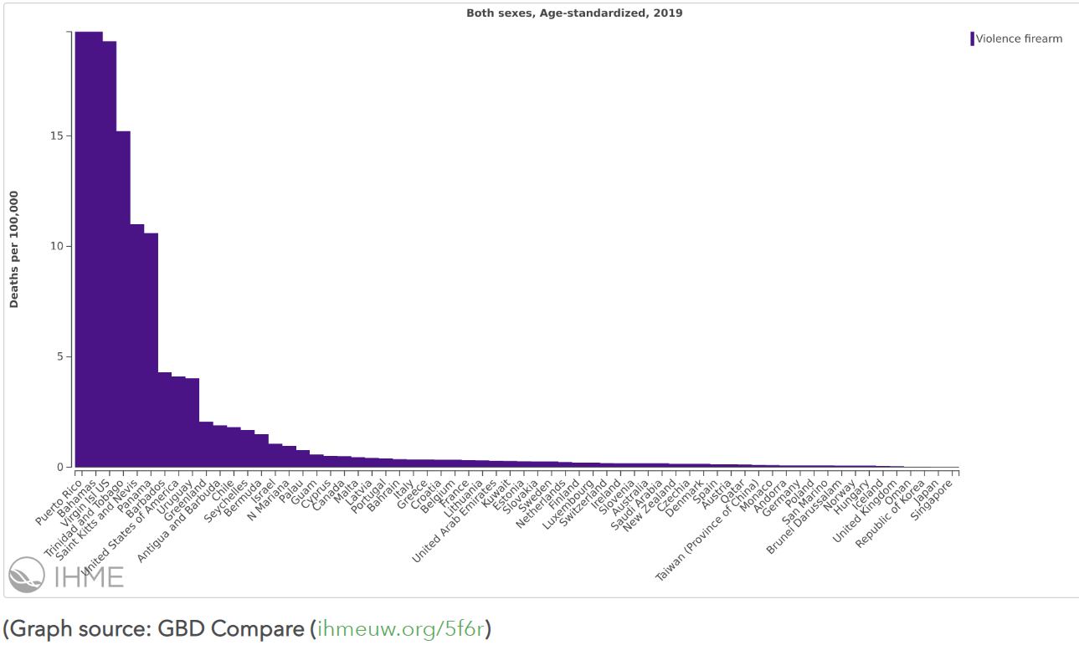
Overview
Background: In 2019, the U.S. ranked eighth out of 64 high-income countries & territories for homicides by firearm with ​Puerto Rico and the US Virgin Islands, two US territories, ranking first and third.
Research Question: Are there aspects of gun policy in the U.S. that predict firearm mortality rate?
https://www.healthdata.org/acting-data/gun-violence-united-states-outlier

Slide 3
Data -
https://github.com/JAbinette/CUNY-607-Final-Project
U.S. Cause of Death by Firearm
Queried from CDC https://wonder.cdc.gov grouped by State, Year and Cause of Death excluding Terrorism, Legal Intervention and Operations of War
458 observations for 11 variables
‘0 - wonder.cdc.gov Underlying Cause of Death cdc - Grp by State, ICD Sub-Chapter.txt’
Firearm Laws by State
Database published on https://www.statefirearmlaws.org/resources containing detailed annual information on firearm-related laws in place
1500 observations for 137 variables
‘0 - statefirearmlaws.org Firearm Laws - DATABASE_0.xlsx’

Slide 4
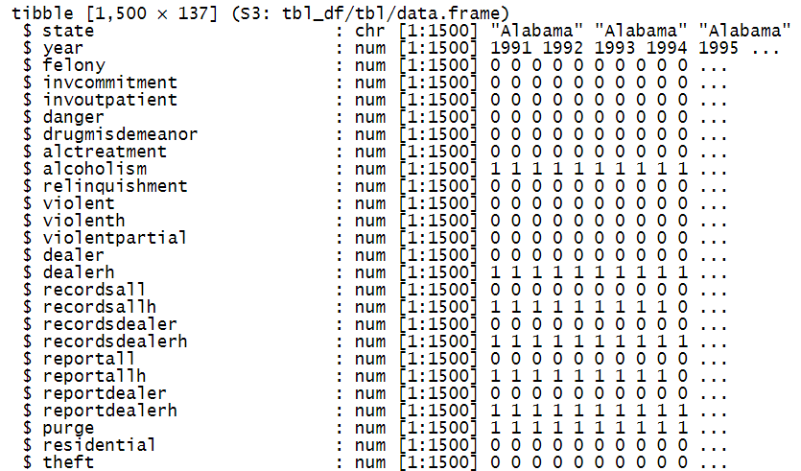
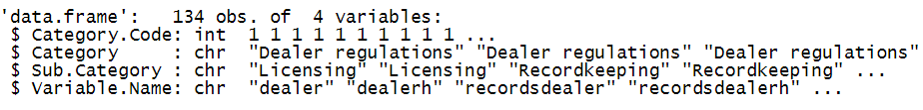
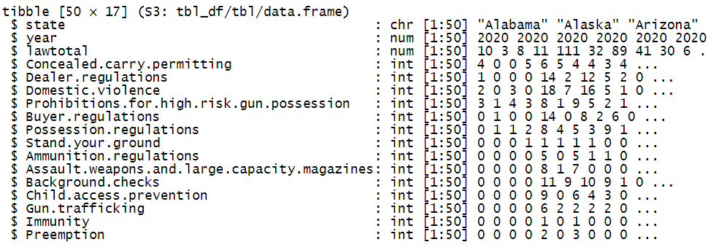
Transformation - Firearm Laws by State
134 of 137 variables are specific provisions
part of 14 categories
The absence/presence of 134 provisions of law were rolled up to the sum of present provisions for each category

Slide 5
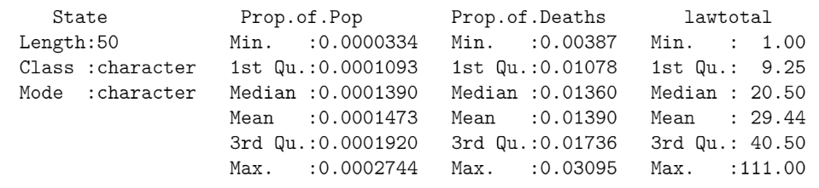
Can the Total # of Firearm Laws Predict Proportion of Firearm Deaths per State Population?
Simple Linear Regression

Slide 6
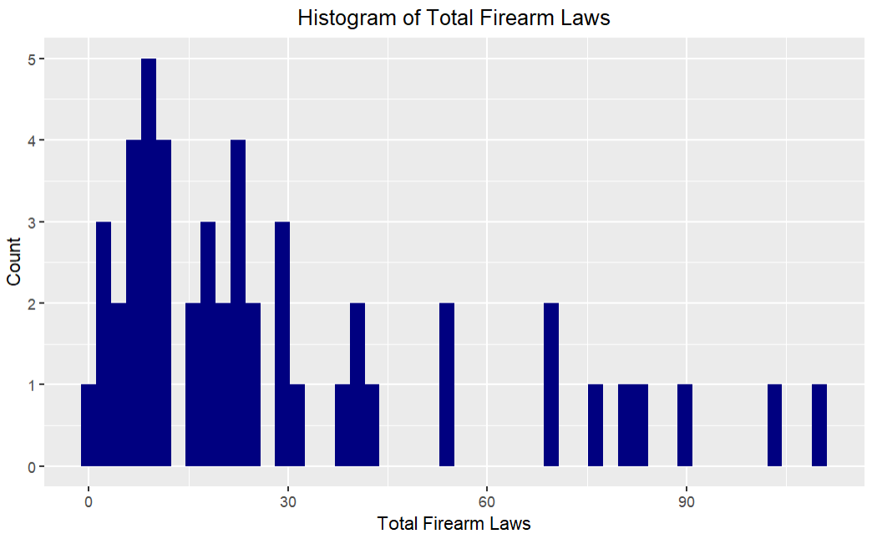
Firearm Laws
Mean | 29.44
Median | 20.50
Std Dev | 28.24
IQR | 31.25

Slide 7
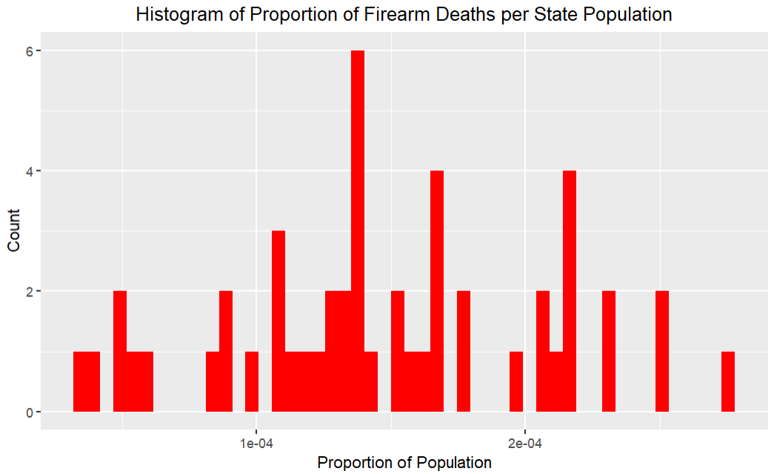
Proportion of Population
Mean | .0001473
Median | .0001390
Std Dev | 5.909e-05
IQR | 8.262e-05

Slide 8
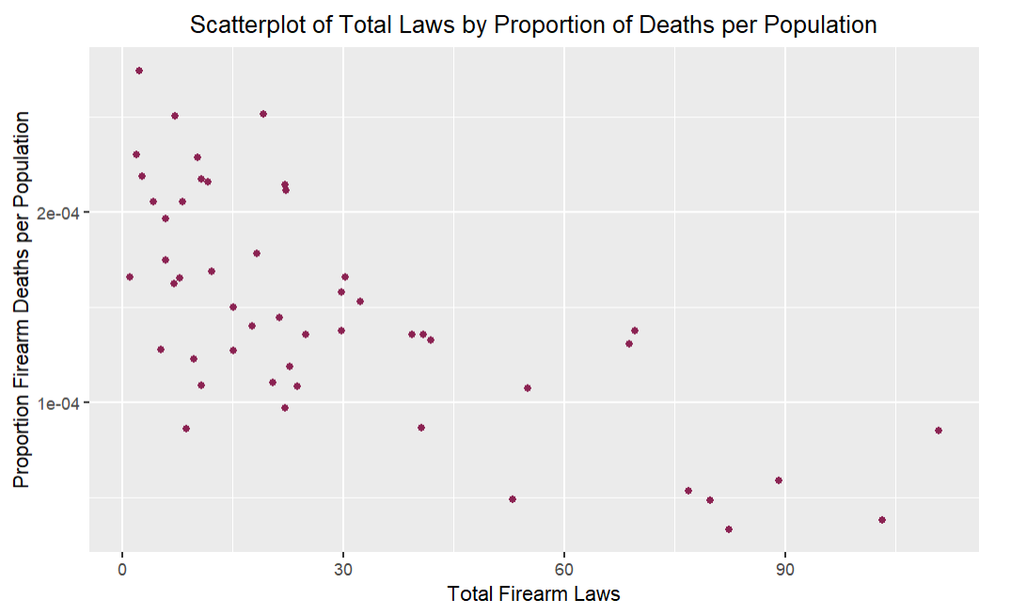
Total Firearm Laws x Proportion of Population
Correlation
-.702

Slide 9
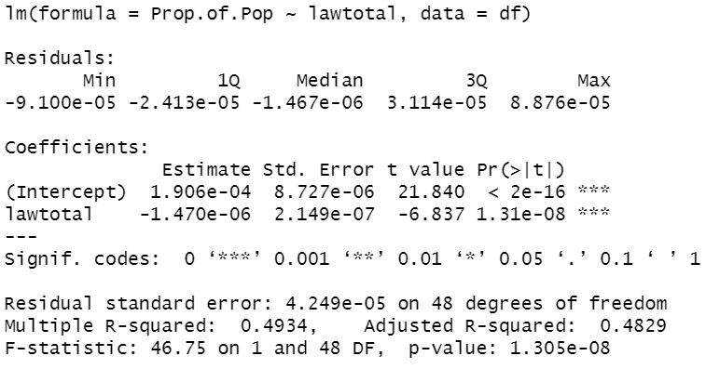
Simple Linear Regression
Proportion of Population = 1.906e-04 – 1.470e-06 x Law.Total
Total number of firearm laws is a statistically significant predictor of Proportion of Firearm Deaths per Population
R-squared indicates the model accounts for 49.34% of the variability.

Slide 10
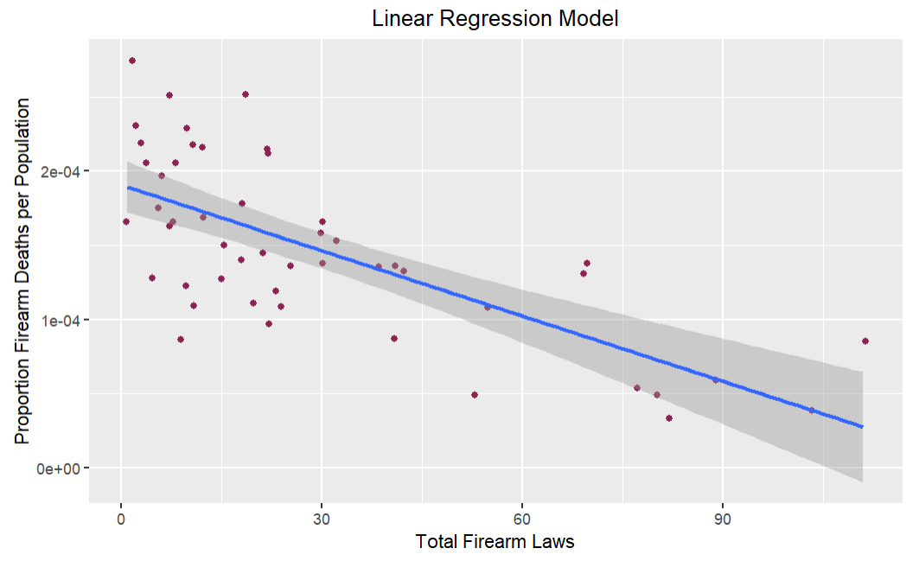
Can We Make a Better Model?

Slide 11
Can the Number & Category of Laws predict proportion of Firearm deaths per State Population?
Multiple Linear Regression
Category | Provisions | Mean | Median
Domestic violence | 21 | 5.64 | 3.50
Buyer regulations | 17 | 2.76 | 1.00
Dealer regulations | 17 | 2.78 | 0.50
Possession regulations | 12 | 3.02 | 2.50
Background checks | 11 | 3.20 | 0.00
Prohibitions for high-risk gun possession | 11 | 3.26 | 3.00
Child access prevention | 11 | 1.90 | 0.00
Assault weapons and large-capacity magazines | 8 | 0.80 | 0.00
Concealed carry permitting | 7 | 3.38 | 4.00
Ammunition regulations | 7 | 0.72 | 0.00
Gun trafficking | 7 | 0.78 | 0.00
Preemption | 3 | 0.40 | 0.00
Stand your ground | 1 | 0.44 | 0.00
Immunity | 1 | 0.34 | 0.00

Slide 12
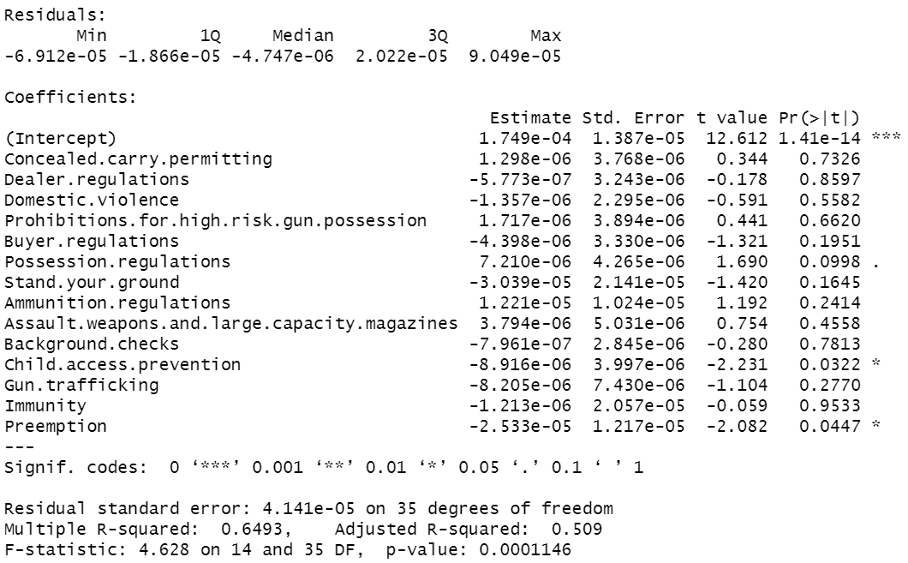
Multiple Linear Regression - Full Model
Adjusted R-squared indicates the model accounts for 50.9% of the variability, but many predictors are not statistically significant

Slide 13
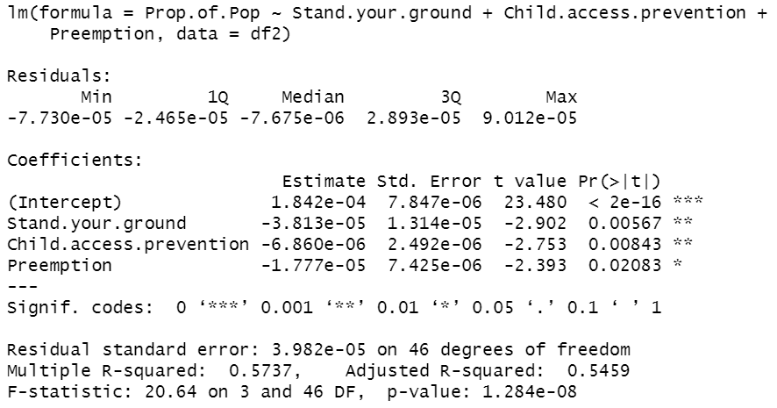
Multiple Linear Regression – Backward-Selection
Adjusted R-squared increased ~4% to account for 54.6% of the variability
1.842e-04
– 3.813e-05 x Stand.Your.Ground
– 6.860e-06 x Child.Access.Prevention
– 1.777e-05 x Preemption

Slide 14
Multiple Regression Model Conditions
Residuals are Nearly Normal
Variability of the Residuals is Nearly Constant
Residuals are Independent
Each Variable is Linearly Related to the Outcome

Slide 15
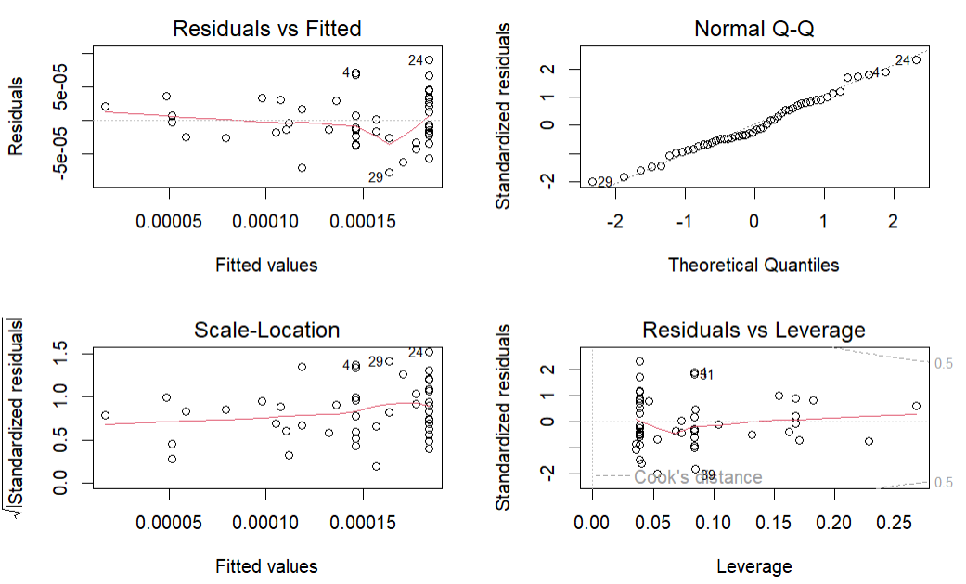

Slide 16
Conclusion
Total number of firearm laws is a significant predictor and accounts for 49% of the variability in Firearm Deaths as a Proportion of the State Population
In breaking down the firearm laws by category, a multiple regression analysis determined that the number of Stand Your Ground, Child Access Prevention, and Preemption firearm laws can explain 55% of the variability.
Satisfaction of model conditions may be questionable as slight normality issues in residual plots
Future analysis could explore firearm provisions in more detail and comparing by year the changes in State firearm laws and the affect on firearm mortality
Are there aspects of gun policy in the U.S. that predict firearm mortality rate?

Slide 17
Thank you

